Slide 1
Project Report
AI Driven Quality Control
09.2026

Slide 2
Table of Contents
1
  Introduction
2
  Background
3
  Project Progress
4
  Other Projects

Slide 3
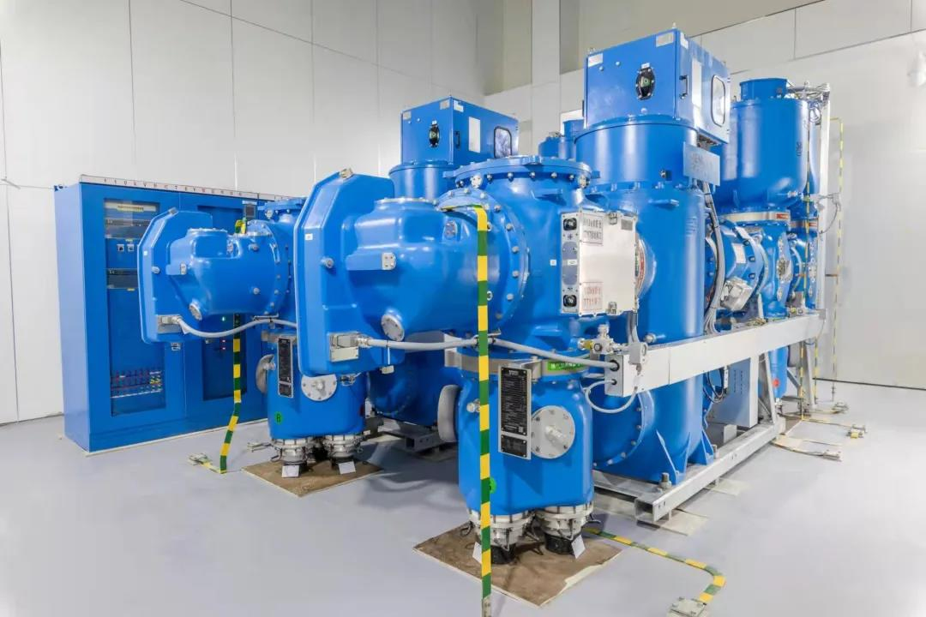
1 Introduction
About Us
Shanghai Siemens Energy High Voltage Switchgear Co., Ltd.
Shanghai Siemens Energy High Voltage Switchgear Co., Ltd., established in 2001, is a Sino-foreign joint venture jointly invested by Siemens Energy GmbH and Shanghai Electric Group Transmission & Distribution Equipment Co., Ltd. The company specializes in the research, development, manufacturing, sales, and service of high-voltage gas-insulated switchgear (GIS) rated at 52 kV and above, with products exported to 58 countries and regions.

Slide 4
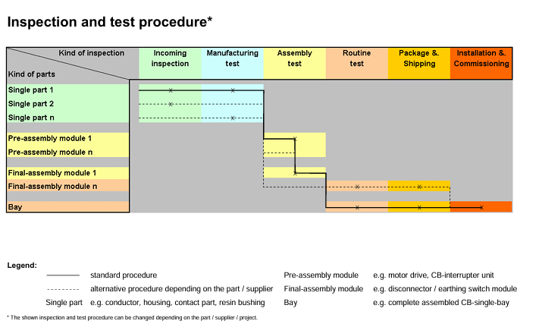
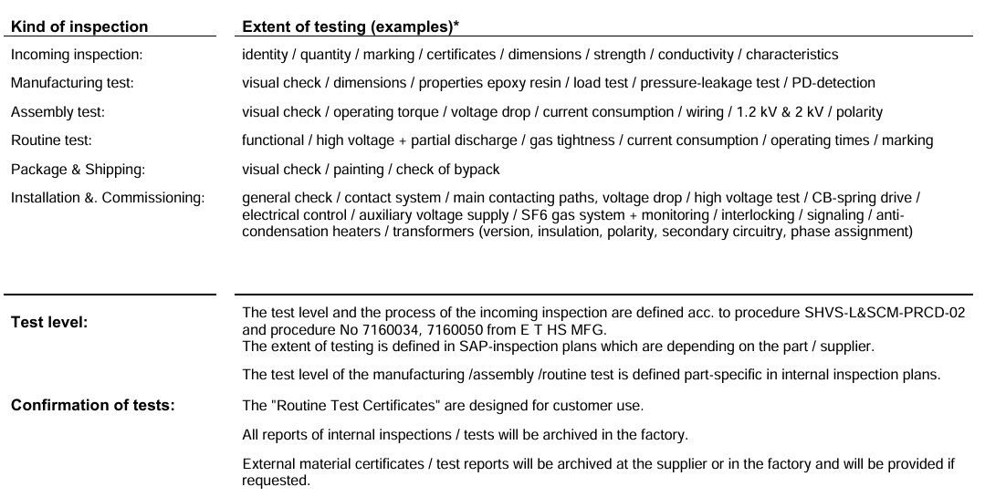
1 Introduction
Quality Control in the Company

Slide 5
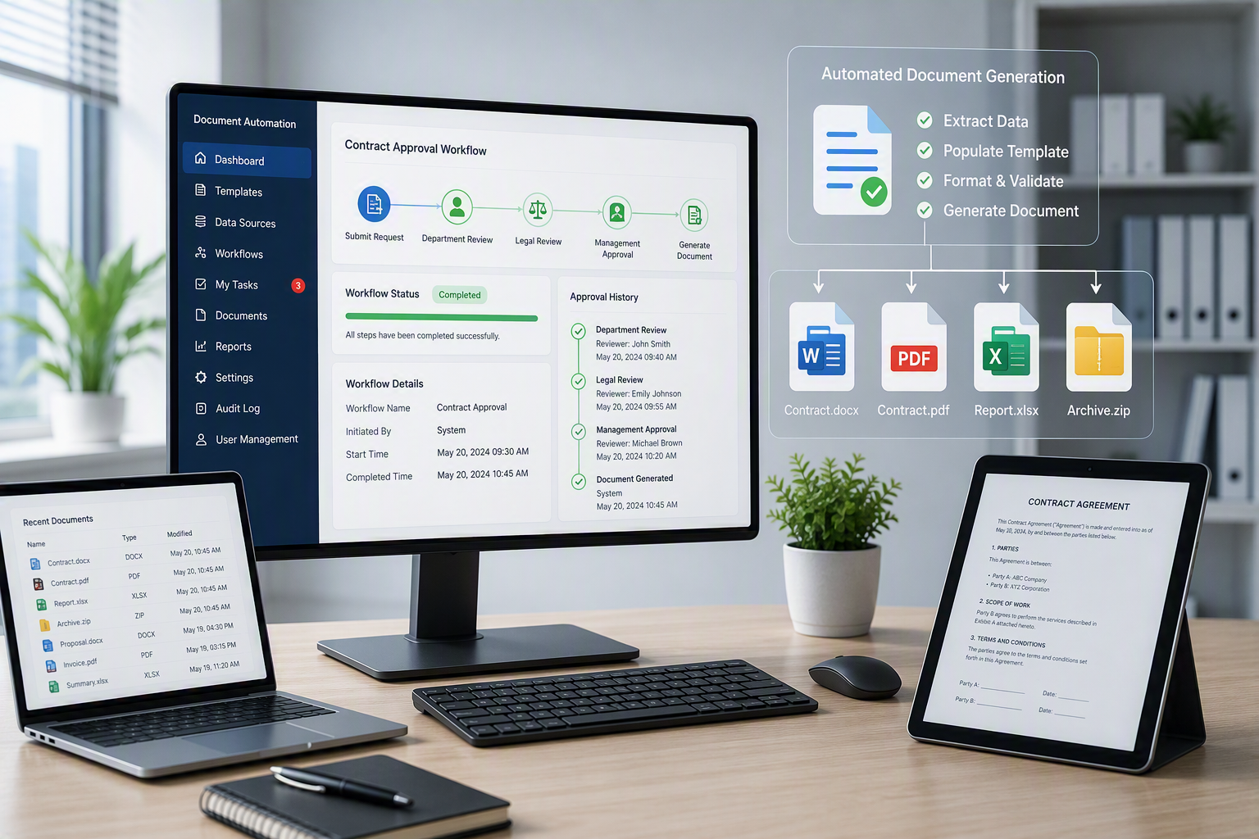
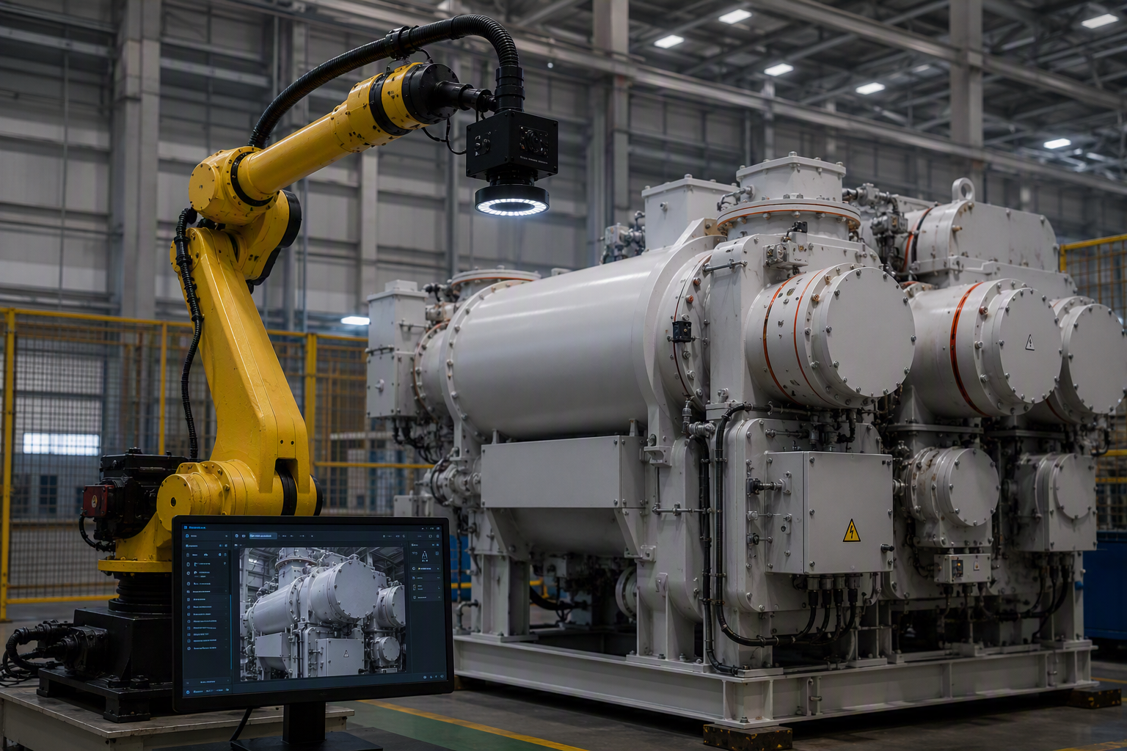
1 Introduction
Vision for Digitalization and AI Usage
Automation of file organization, storage, and completeness verification throughout the quality control process
AI-assisted screening and abnormality warning of quality inspection record
1
3
2
AI-assisted information summarization and key point extraction
4
Machine-Vision-based automatic Gas Insulated Switchgear (GIS) inspection

Slide 6
Table of Contents
1
  Introduction
2
  Background
3
  Project Progress
4
  Other Projects

Slide 7
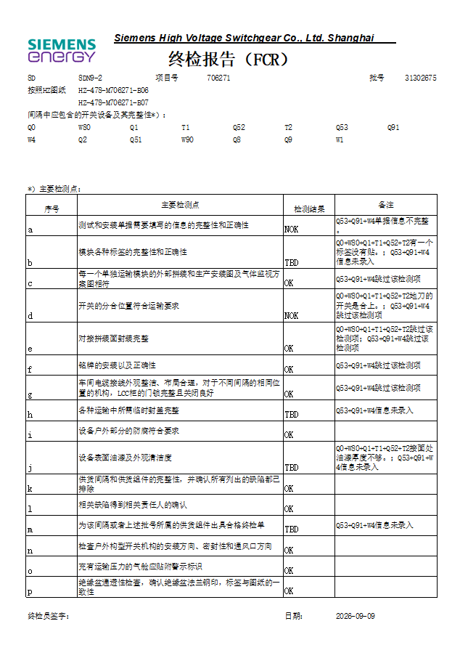
2 Background:
Current Project: Generating Final Control Report with Rokid Glasses
Overview
The scope of Outgoing Quality Control (OQC) includes all outgoing GIS and modules, reproduction modules/components and pre-assembly modules in SHVS factory.
OQC is the final quality gate before packaging and shipping, mainly focused on surface finish, structural conformance with the drawing, etc..
Final Control Report (FCR) serves as a record of inspection and will be archived for 25 years.
State of art / Pain points
FCR is still done manually.
Image record and file management always takes up a lot of time.
Target:
Automation in generating the FCR.
Image capture with the help of the glasses.
Automated document archiving.
Image: Example of a final control report

Slide 8
2 Background
Workflow of Final Quality Control
(Arrival of devices in final control area)
Inspection start
Go through all Inspection items.
Are there any quality issues?
Yes
No
Problem report:
Take photos and report it to Quality team
Root cause definition
Go back to problem report
Corrective measure by corresponding department
Has the Corrective measure taken effect?
No
Yes
Repair process documentation in Monthly Report
Start inspection again for other transportation cells
No
All transportation cells inspected?
Yes
Take photos of final state and document it in Final Control Report (FCR)
Packaging and Shipping

Slide 9
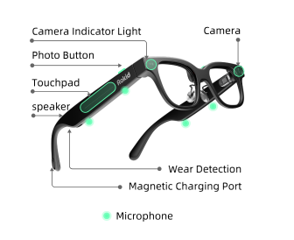
2 Background:
Rokid AI Glasses
Hardware
Main Functions
Dev Platforms
Consumer System
1
Camera
2
Microphone
AIUI Studio
UI design
YodaOS-Sprite
OS for glasses consumer
3
Display
4
AI Agent Functions
Rizon
AI Agent setup
Enterprise System
Specifications:
https://open.rokid.com/sprite?lang=en
Android Studio
UI and App design
Rokid Sprite Enterprise
SDK for glasses enterprise
Notes:
Rizon:
A low-code platform for building and deploying AI Agents by integrating its capabilities of workflows, databases, knowledgebases and plugins.
AIUI Studio:
A platform based on the AIUI (AI-Native User Interface) framework for building interactive and intuitive interfaces for the content displayed on the glasses.
SDK:
Development toolkits for both glasses and Android device, enabling data communication and completion of complex functions on both sides.

Slide 10
Table of Contents
1
  Introduction
2
  Background
3
  Project Progress
4
  Other Projects

Slide 11

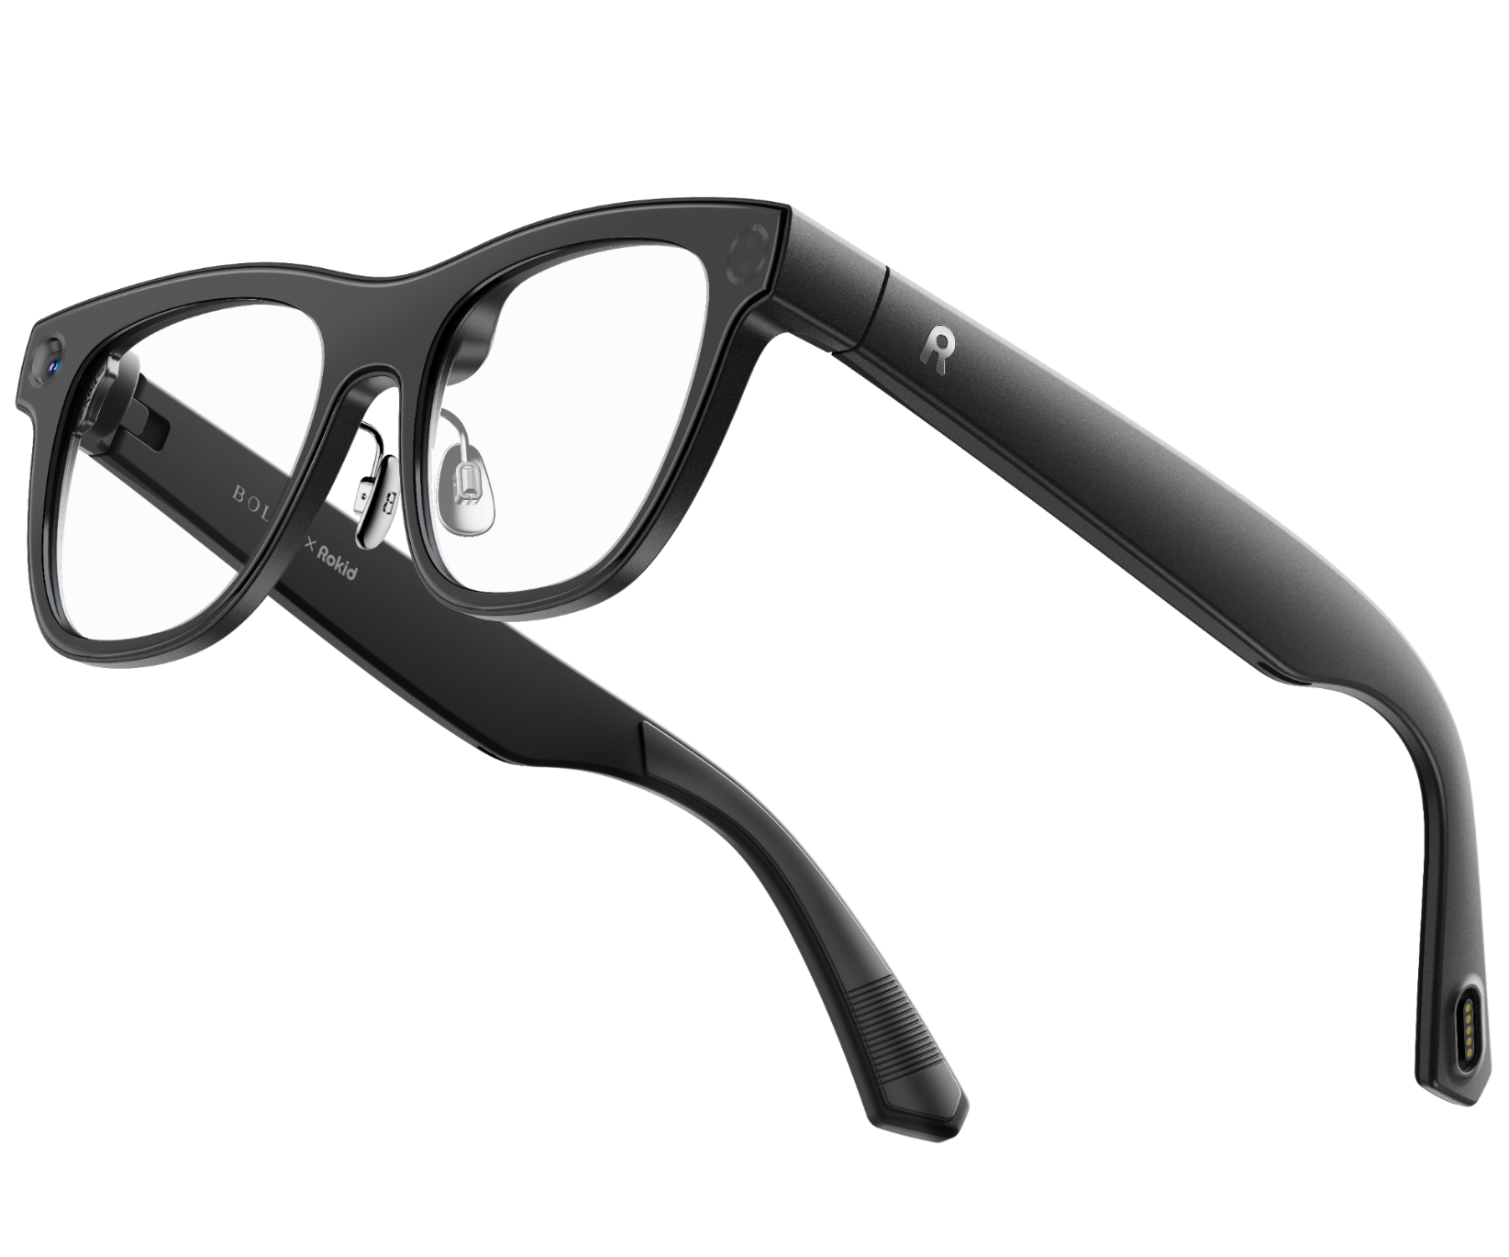


3 Project Progress
Workflow of generating FCR with glasses
3 Load inspection items based on device model
6 Write inspection results in the database
706271 D01 Indoor
Q53+Q91+W4
Device Model | Insp. Id | Insp. Item
8DN9-2 | a | Verify the information required to fill out in assembly documents.
8DN9-2 | b | Check the consistency of assembly and technical drawing
8DN9-2 | … | …
Database
Input
CozeCode
API
7 Export inspection results as intermediate table
Scan
Table
Inter-mediate
1 Scan QR Code on the mark of the device
4 Display inspection items on the glasses
Python
{
"device_id": "8DN9-2",
"proj_id": 706271,
"bay_id": "D01",
"batch_id": 31302675,
"hzdrawing_page": "HZ-478-M706271-B07",
"transportation_cell_symbol": "Q53+Q91+W4“
}
FCR
Output
Inspection a, verify the information required to fill out in assembly documents.
Please confirm whether the device is qualified for this inspection item?
8 Fill in the FCR with corresponding data
Photo that contains the QR Code
Input
API
CozeCode
5 Input inspection result
9 Adjust the FCR
(Format, Content, etc.)
Decoded information
Output
2 Save project and device information
OK
Device model Project No.
Bay No. Batch No.
Drawing pages Module symbols
NOK+Reason
10 Finish
Skipped

Slide 12
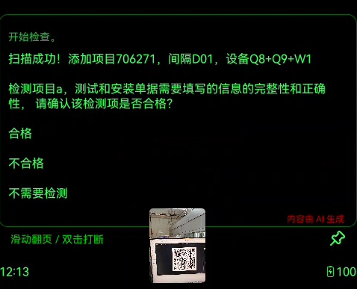
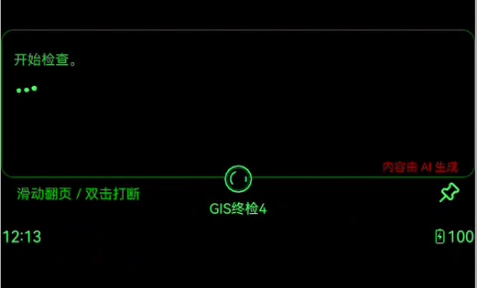
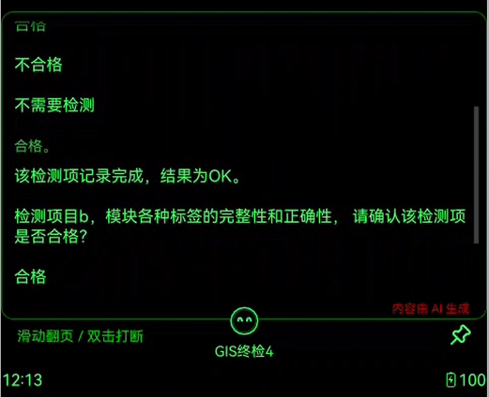
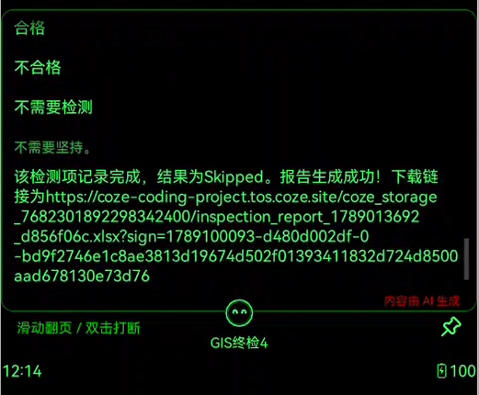
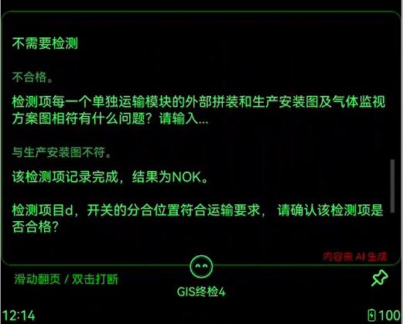
3 Project Progress
Demo
1 Scan QR Code on the mark of the device
2 Save project and device information
3 Load inspection items based on device model
4 Display inspection items on the glasses
Device scanned. Added values: Project No. 706271, Bay D01, Modules Q8+Q9+W1
0 Wake Word
Inspection a, <Display the inspection here>.
Please confirm whether the device is qualified for it?
Start Inspection.
Qualified.
Not Qualified.
Skip this item.
5 Select inspection result
Qualified.
Not Qualified.
Skip this item.
Qualified.
Not Qualified.
Skip this item.
Qualified.
Not Qualified.
Skip this item.
Not Qualified.
Qualified.
Skip this item.
What is wrong with this inspection: <Display the inspection item>
This inspection item has been recorded and marked as OK.
This inspection item has been recorded and marked as Skipped.
<Problem description.>
This inspection item has been recorded and marked as NOK.
Inspection d, check whether DS/ES are in the correct state for transport.
Please confirm whether the device is qualified for it?

Slide 13
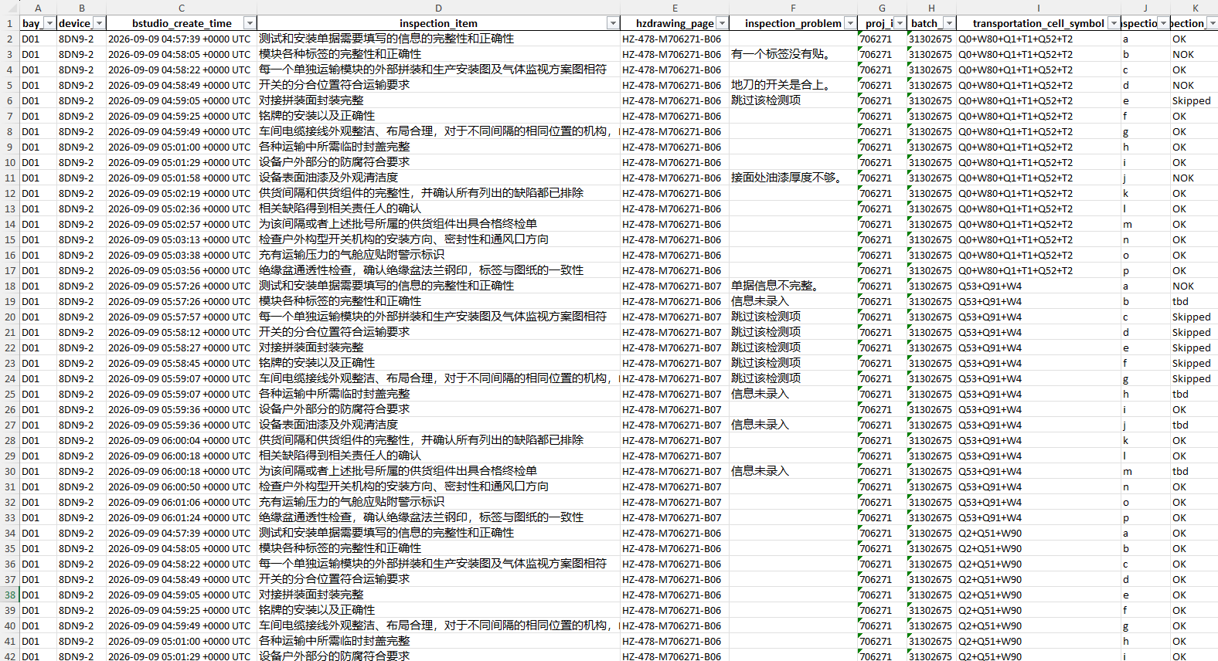
3 Project Progress
Demo
D01
6 Write inspection results in the database
7 Export inspection results as intermediate table
The inspection report has been successfully generated.
The link is https://...
8 Fill in the FCR with corresponding data
9 Adjust the FCR
(Format, Content, etc.)
10 Finish

Slide 14
3 Project Progress
Future Work
Category | Current State | Future State | What GAMI can provide
User interface | The current workflow relies on a chat-based interface to present inspection tasks and guidance. The interaction is not optimal, as the content is not structured displayed, inspection items are not visually emphasized in the text, and key points may be overlooked. | <card> view, where inspection ID, inspection item and other content are displayed in their own blocks. Visually emphasize the inspection item by making the font bold or bigger. <button> elements for inspection results. | - UI designer
Inspection workflow | The current workflow is designed as a linear workflow. If the process is unexpectedly exited, users must restart and repeat all previously completed inspections from the beginning. | Add save checkpoints and an inspection history retrieval function in the workflow that allow the system to determine whether the inspection has started and where was the last checkpoint. | - Process engineer
Knowledge base | Users cannot access historical inspection records through a knowledge base that summarizes issues identified in previous inspections and their corresponding solutions. As a result, valuable knowledge remains siloed within individual experts rather than being systematically captured and shared. | Build a knowledge base (function already embedded in Rizon) that allows users to ask AI agent during the inspection process by providing contextual recommendations and troubleshooting guidance. | - Data analyst
Image capture | Image capture not integrated in the workflow. Glasses can take pictures, but they can only be transferred to phones via App. No solution for data transfer to computers. | Integrate image transfer to computers in the workflow. The images should be categorized and archived in the server. | - Process engineer
Other reports | The current workflow is primarily designed to generate FCR. The data collected from the inspection has the potential to support the creation of various reports In the department. | Further identify and automate other reporting and business workflows by collaborating with the Quality department. | - Process engineer

Slide 15
Table of Contents
1
  Introduction
2
  Background
3
  Project Progress
4
  Other Projects

Slide 16
4 Other Projects
Task | AI-assisted information summarization and key point extraction
Features | An agent which retrieves and answers company-relevant internal information based on RAG (Retrieval-Augmented Generation).
Methods | 1. Collect relevant documents and knowledge. | e.g. internal and external standards, instruction files, history corrective action, photos, etc.
 | 2. Set up the knowledge base. | Save those documents in the knowledge base by semantic segmentation and data vectorization
 | 3. Specify the retrieval workflow. | Specify the agent workflow by writing the agent.md file. Verify whether the recall slice of the knowledge base content is correct or not.

Slide 17
4 Other Projects
Task | AI-assisted screening and abnormality warning of quality inspection record
Features | An agent which utilizes quality tools to analyze and understand the trend of key quality points and issue early warnings for non-conformance (NC).
Methods | 1. Digitalize and automate the entry of monitoring data at these quality points (if possible). | Set up the pipeline for data entry.
 | 2. Use various quality tools to keep track on the quality trend. | e.g. SPC (Statistical Process Control)
 | 3. Set up the agent workflow to automatically analyze data and issue warnings. | Integrate the analysis process (e.g. SPC) into the agent workflow. Specify standard value and tolerance. Also specify when, what and how to inform when NC occurs.

Slide 18
4 Other Projects
Task | Machine-Vision-based automatic Gas Insulated Switchgear (GIS) inspection
Features | A machine vision model which detects the surface finish and other appearance features of a Gas Insulated Switchgear (GIS) with high accuracy and efficiency.
Methods | 1. Specify the inspection check list for each model. | (Concept) Three level of defects detection First level: surface finish Second level: labels and painting color Third level: structural conformance to the drawing
 | 2. Collect training data and train the machine vision model.
 | 3. Deploy several robot arms equipped with high-resolution cameras. | Specify inspection points/routes for each module.
 | 4. Validate its accuracy at inspection.

